Slide 1
Historical Hurricane Analysis
Cody Wittmaack

Slide 2




Data Sources
Temperature Data - National Centers for Environmental Information - https://www.ncei.noaa.gov/
North Atlantic Hurricane Occurrences - Our World in Data - https://ourworldindata.org/grapher/frequency-north-atlantic-hurricanes
Landfall Hurricane Occurrences - Historical Global Tropical Cyclone Landfalls - Jessica Weinkle, Ryan Maue, & Roger Pielke Jr - https://journals.ametsoc.org/view/journals/clim/25/13/jcli-d-11-00719.1.xml?tab_body=pdf
Coastal Population Data - National Oceanic & Atmospheric Administration - https://coast.noaa.gov/quickreport/#/index.html
Hurricane Damage Data - National Centers for Environmental Information - https://www.ncei.noaa.gov/access/billions/time-series/US
Technologies Used
Data Cleaning
Google Sheets
Python
Jupyter Notebooks
Exploratory Data Analysis
Python
Pandas
Matplotlib
Seaborn
Jupyter Notebooks
Visualizations
Tableau
Python
Seaborn
Matplotlib

Slide 3
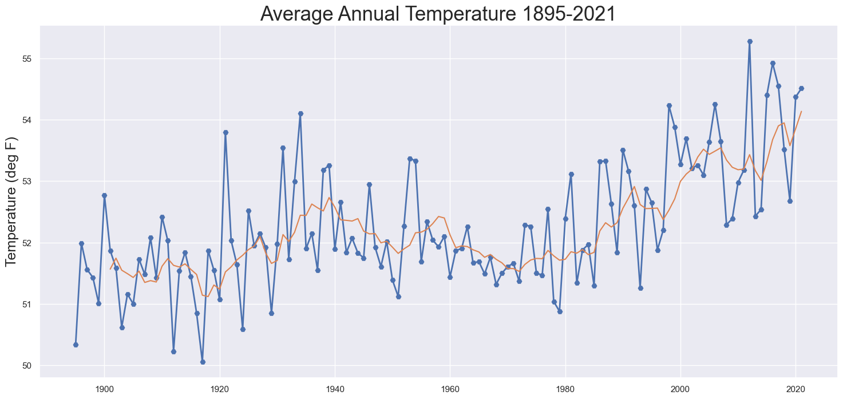
Global Warming is Apparent
Average global surface temperature has risen at a rate of 0.17°F per decade since 1900 or roughly 2°F from 1900 to 2020.

Slide 4
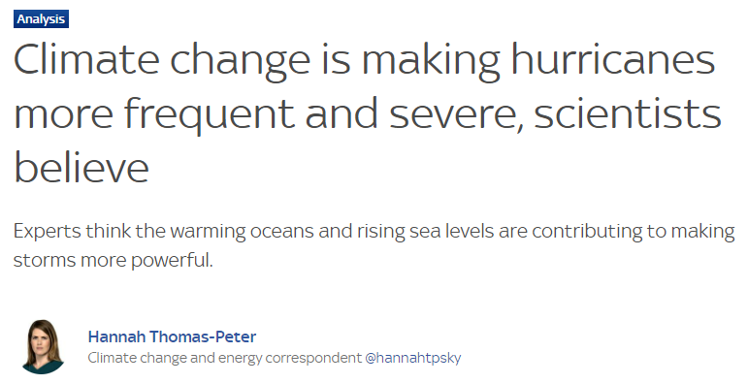
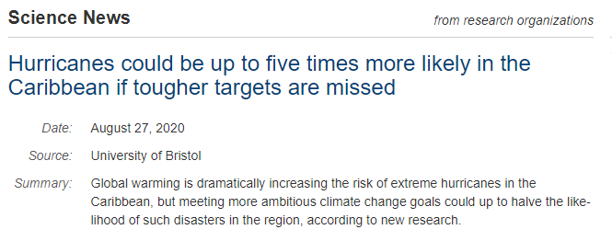
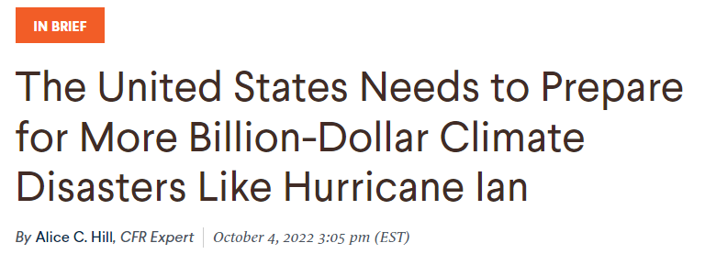
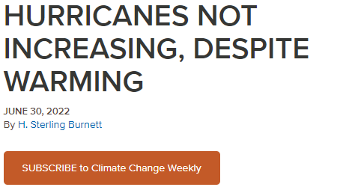
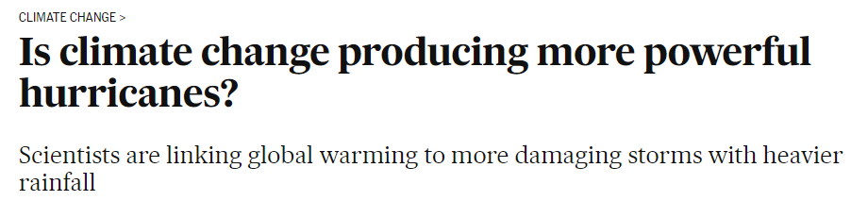
Is Global Warming Impacting the Frequency & Intensity of Hurricanes?

Slide 5
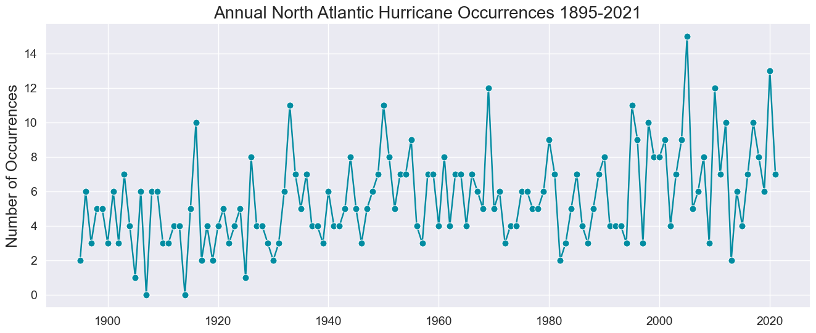
Trend in North Atlantic Hurricane Frequency 1895-2021

Slide 6
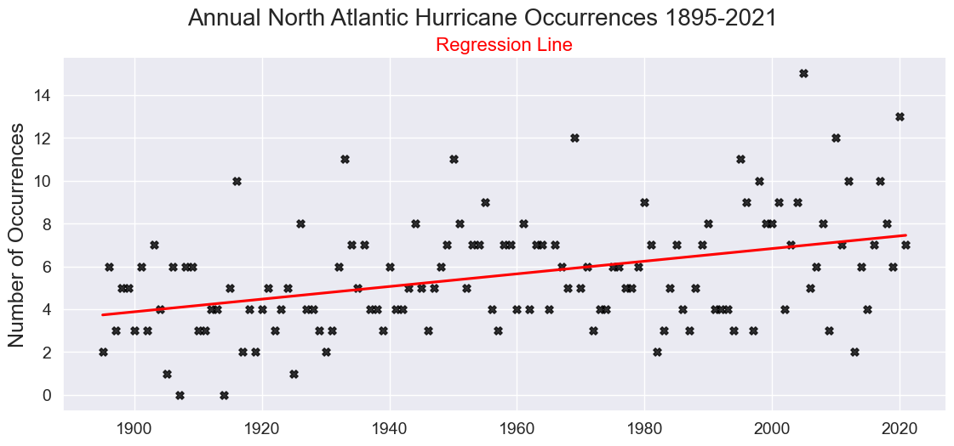
Regression for North Atlantic Hurricanes 1895-2021

Slide 7
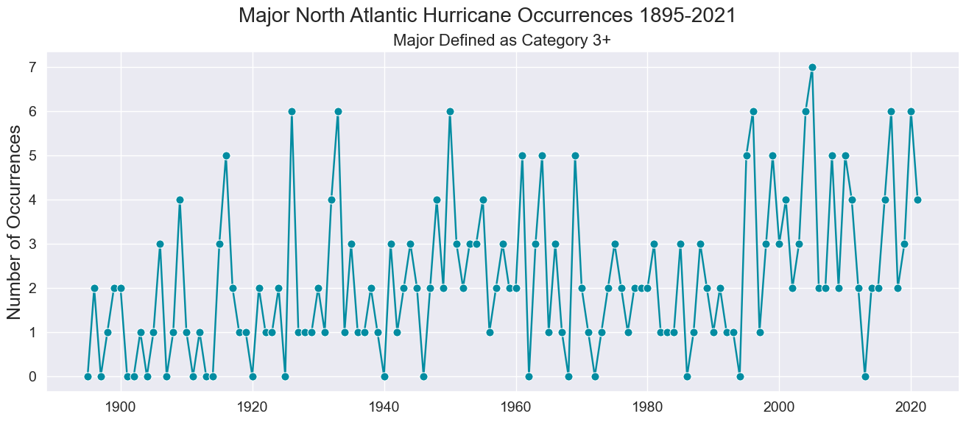
Trend in MAJOR North Atlantic Hurricane Frequency 1895-2021

Slide 8
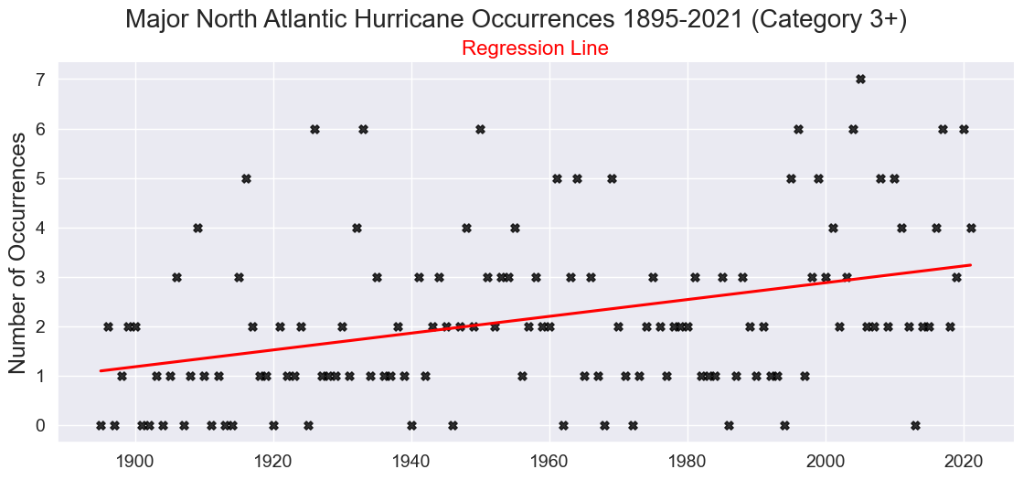
Regression for MAJOR North Atlantic Hurricanes 1895-2021

Slide 9
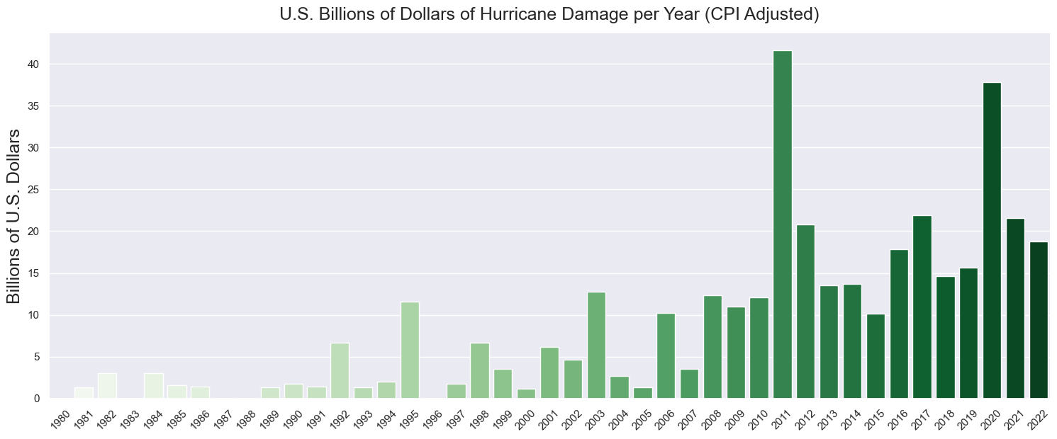
Historical U.S. Hurricane Damage

Slide 10
Back to the question at hand…
Is Global Warming Impacting the Frequency of Hurricanes?
Based on that data…yes, case closed!
Hold up…how was this data obtained?

Slide 11
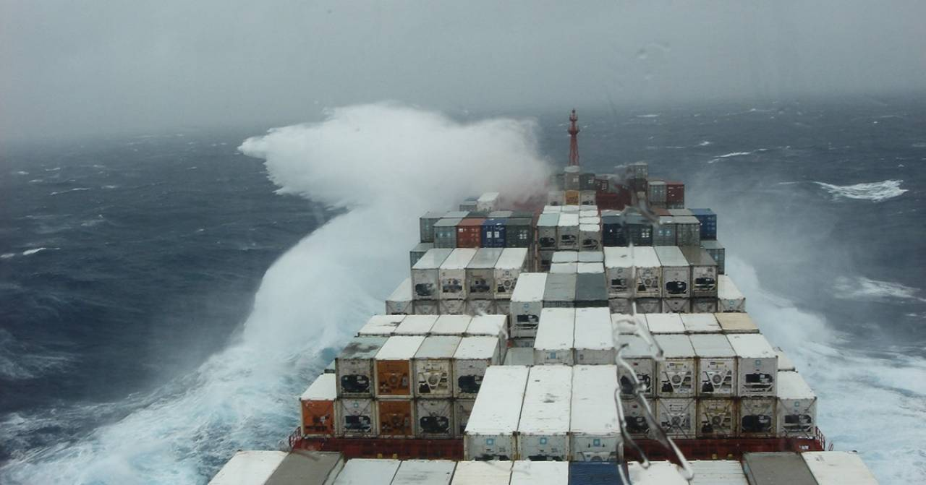
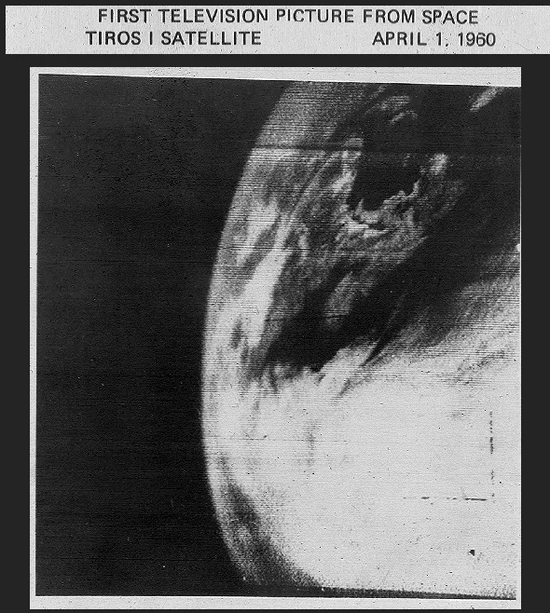
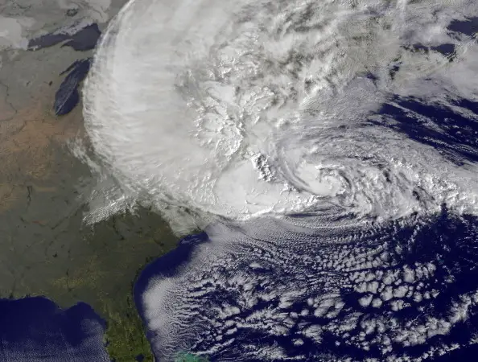
Hurricane Detection
Early Detection
Reported by ships.
Landfall
Primary methods until early 1970’s.
Modern Detection
Satellite imagery.
First image generated on 4/1/1960 but not considered reliable until around 1972.

Slide 12
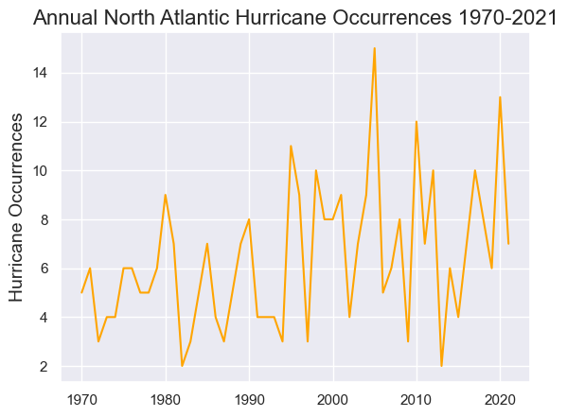
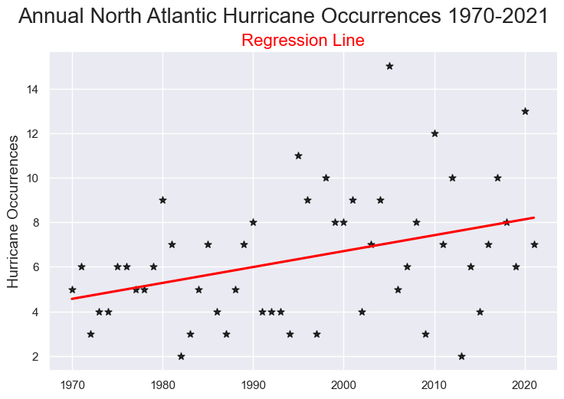
Why Does this Matter?
It is likely hurricanes prior to satellite technology were undercounted.
This would skew the data!
How can we reconcile this?

Slide 13
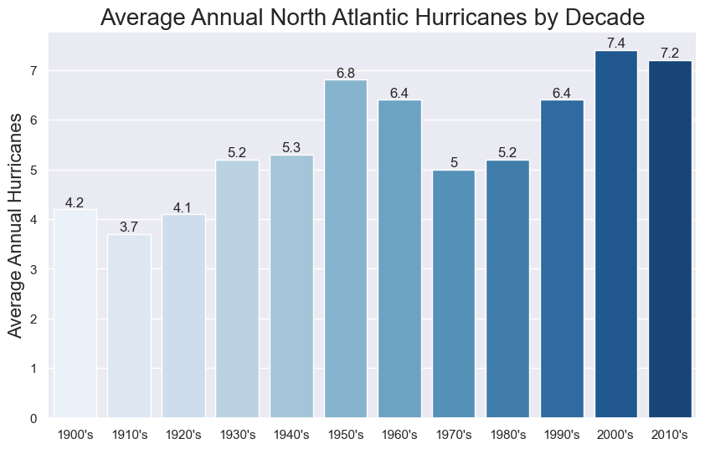
Conclusion? Not so Fast!
By reducing the sample size of the data we allow natural variations to impose more weight on the results.
Total North Atlantic Hurricanes from the same data set shows occurrences dropped 22.7% for the 50’s and 60’s compared to the 70’s and 80’s.
This likely points to a lull in hurricane activity over that period.

Slide 14
Landfall
A hurricane making landfall is defined as the eye of the storm passing over land.
This is much more reliable as it’s less likely an event like this was not recorded.
Fortunately there is good data for the North Atlantic Basin and West Pacific Basin starting in 1950 which makes up roughly 70% of all hurricane landfall events.

Slide 15
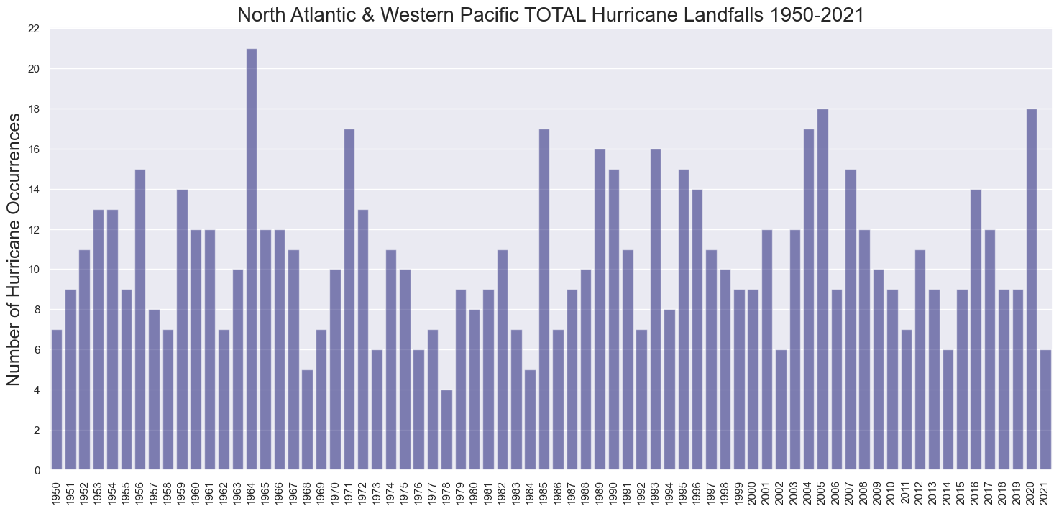
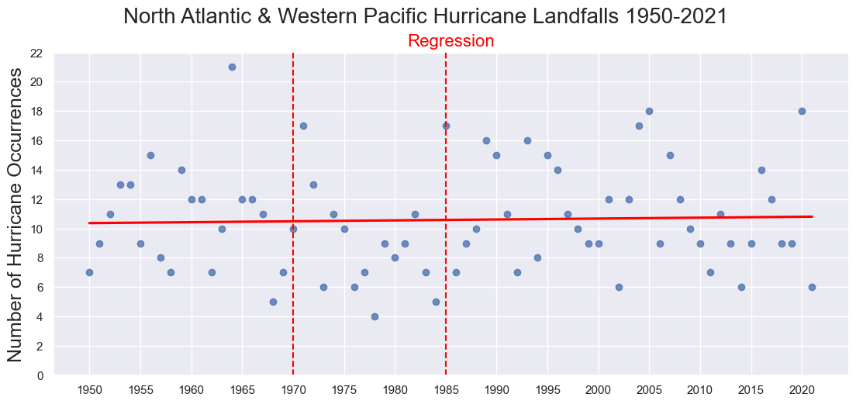
Landfall Analysis for Frequency

Slide 16
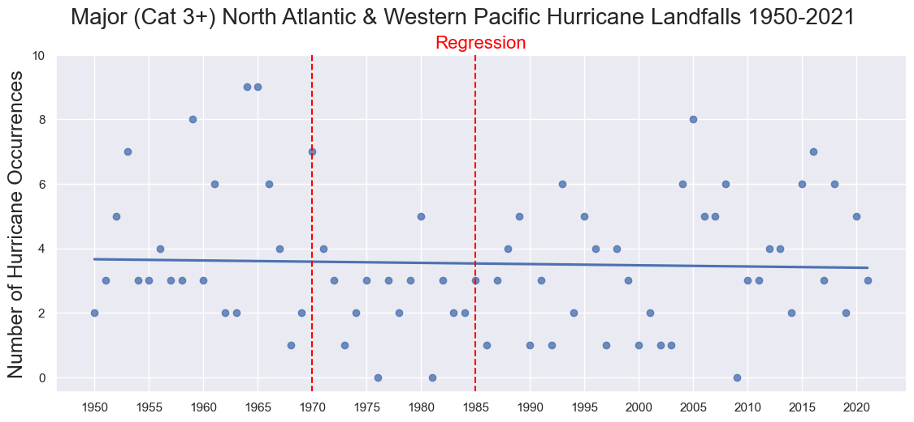
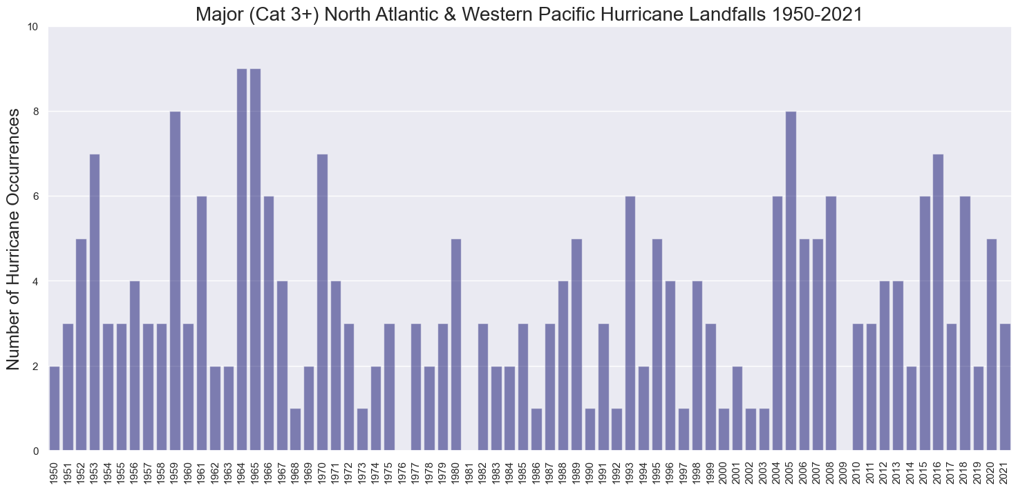
Landfall Analysis for Intensity

Slide 17
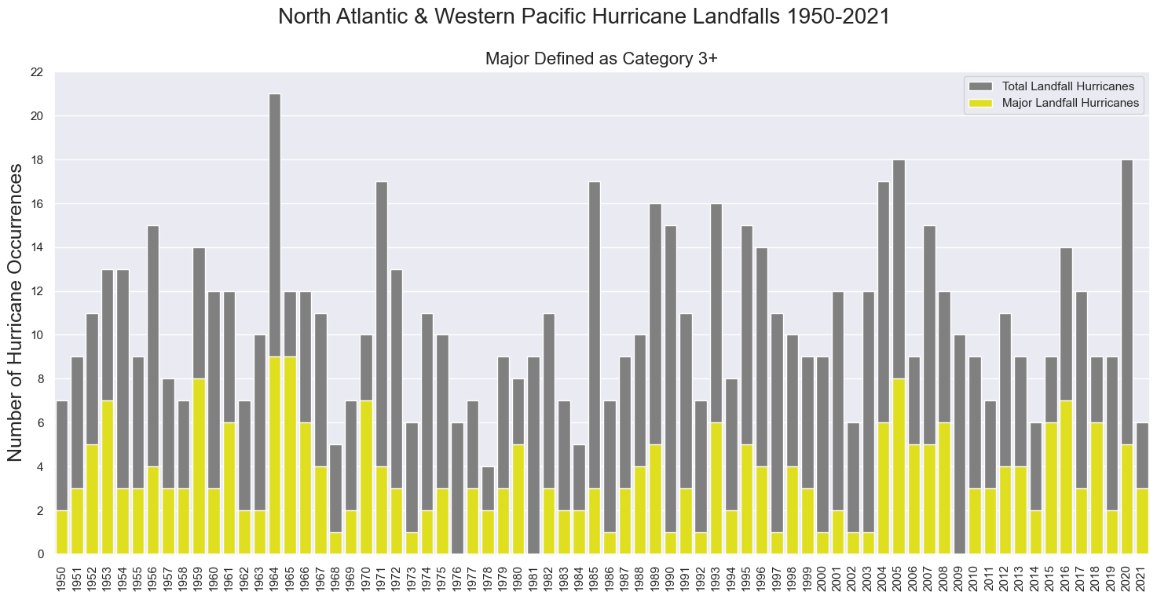
Frequency & Intesnity

Slide 18
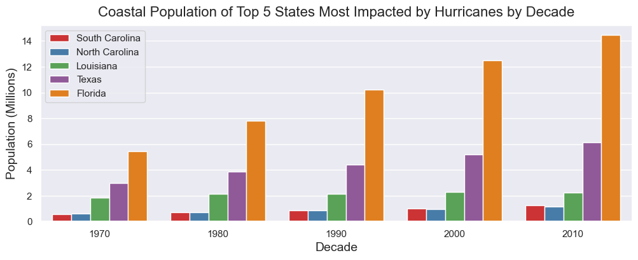
What About the Increase in Damages though?

Slide 19
Conclusion
“Data doesn’t lie. People do. If your data is biased, it is because it has been sampled incorrectly or you asked the wrong question, whether it be deliberately or otherwise.” - Lee Baker, Truth, Lies, & Statistics: How to Lie with Statistics.
The true story highlighted in this analysis is how data can be used to drive a narrative in almost any direction desired.
This analysis indicates no strong evidence of increasing frequency or intensity of Hurricanes.
This is not to say climate change isn’t taking place.
Some evidence of hurricanes moving more slowly which may result in more damage.

